Slide 1
Gordon Parks

Slide 2
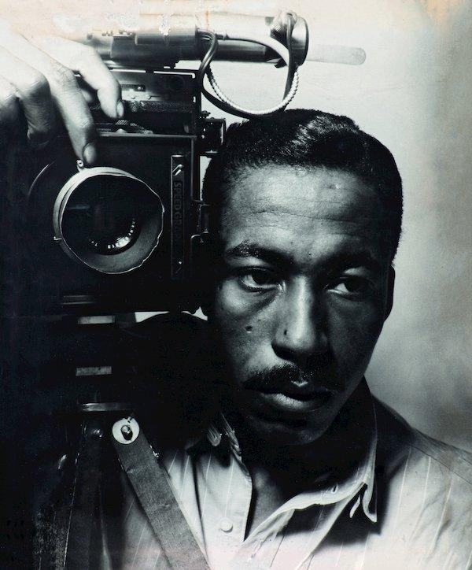
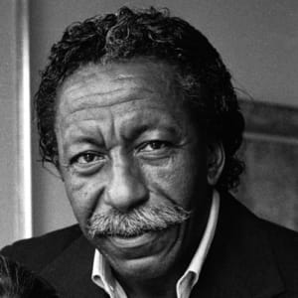

Slide 3
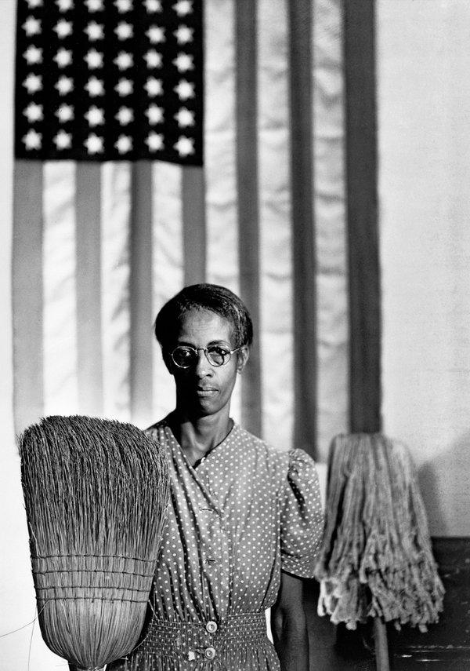
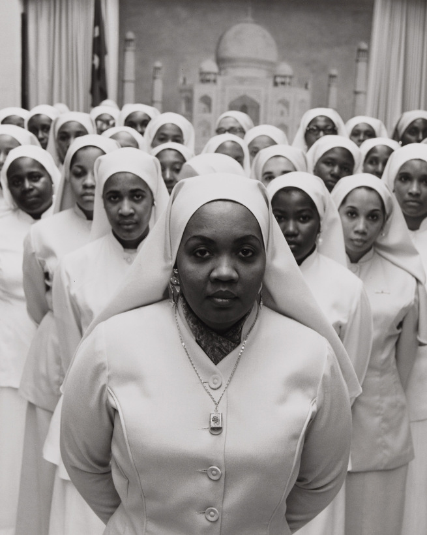
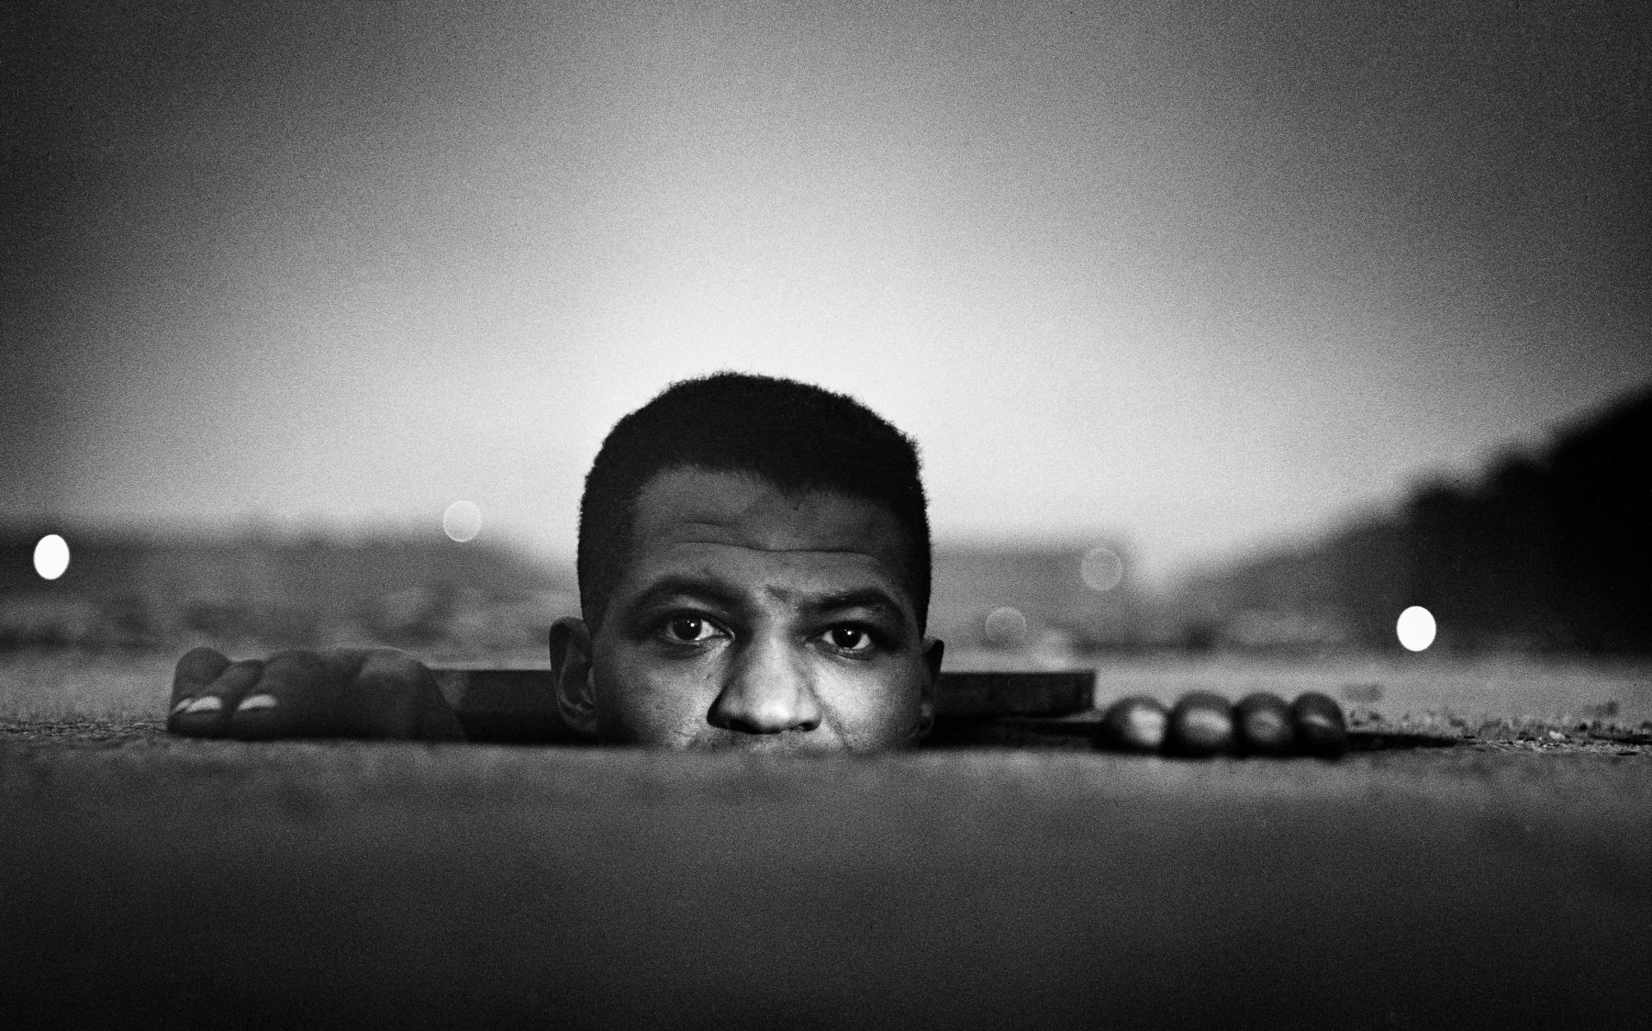

Slide 4
1912-2006
Youngest of 15
Attended a segregated junior school
Left school at 15
First camera at 25
Self taught photographer
Best known for documenting issues of civil rights, poverty , race relations and urban life
Freelance fashion for Vogue
Life magazine photographer

Slide 5
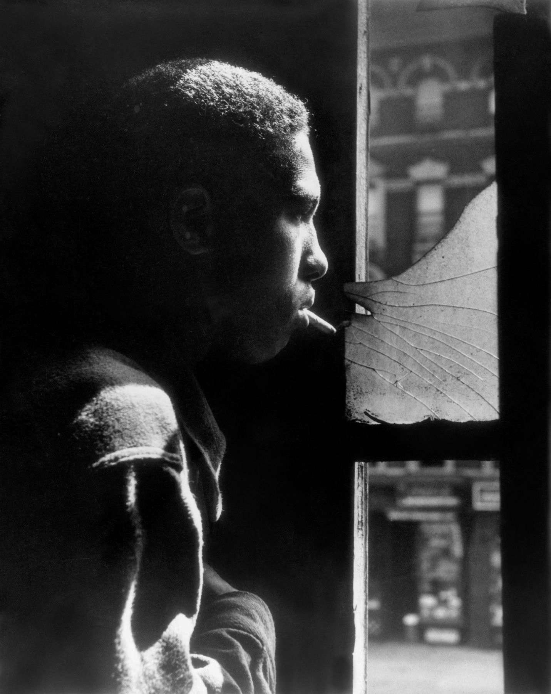

Slide 6
Red Jackson
17 year old Harlem gang leader
Reflects both potential violence and vulnerability
Single source of light (natural sunshine)
Hard lighting, deliberately no effort to soften the image
Fairly narrow depth of field
Light angled down on subject (Butterfly set up)
Shot taken at approx 110 degrees to light source
The room and most of subject are in darkness
Broken glass and blurred street opposite reminding us we are in deprived area

Slide 7
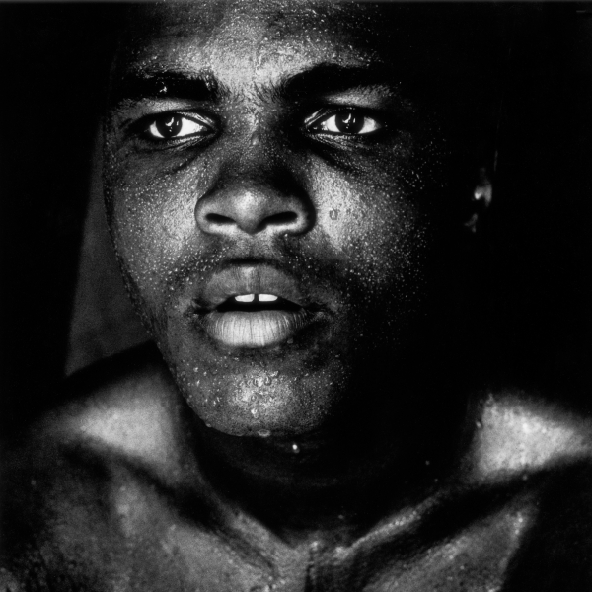

Slide 8
Muhammad Ali
Ali in his prime, post fight/training
Reflects power, menace, ambition
Single light source, slight offset (loup), angled up at subject
Hard lighting
Narrow depth of field
Camera at slight angle to subject, who is looking into distance
Dark background

Slide 9
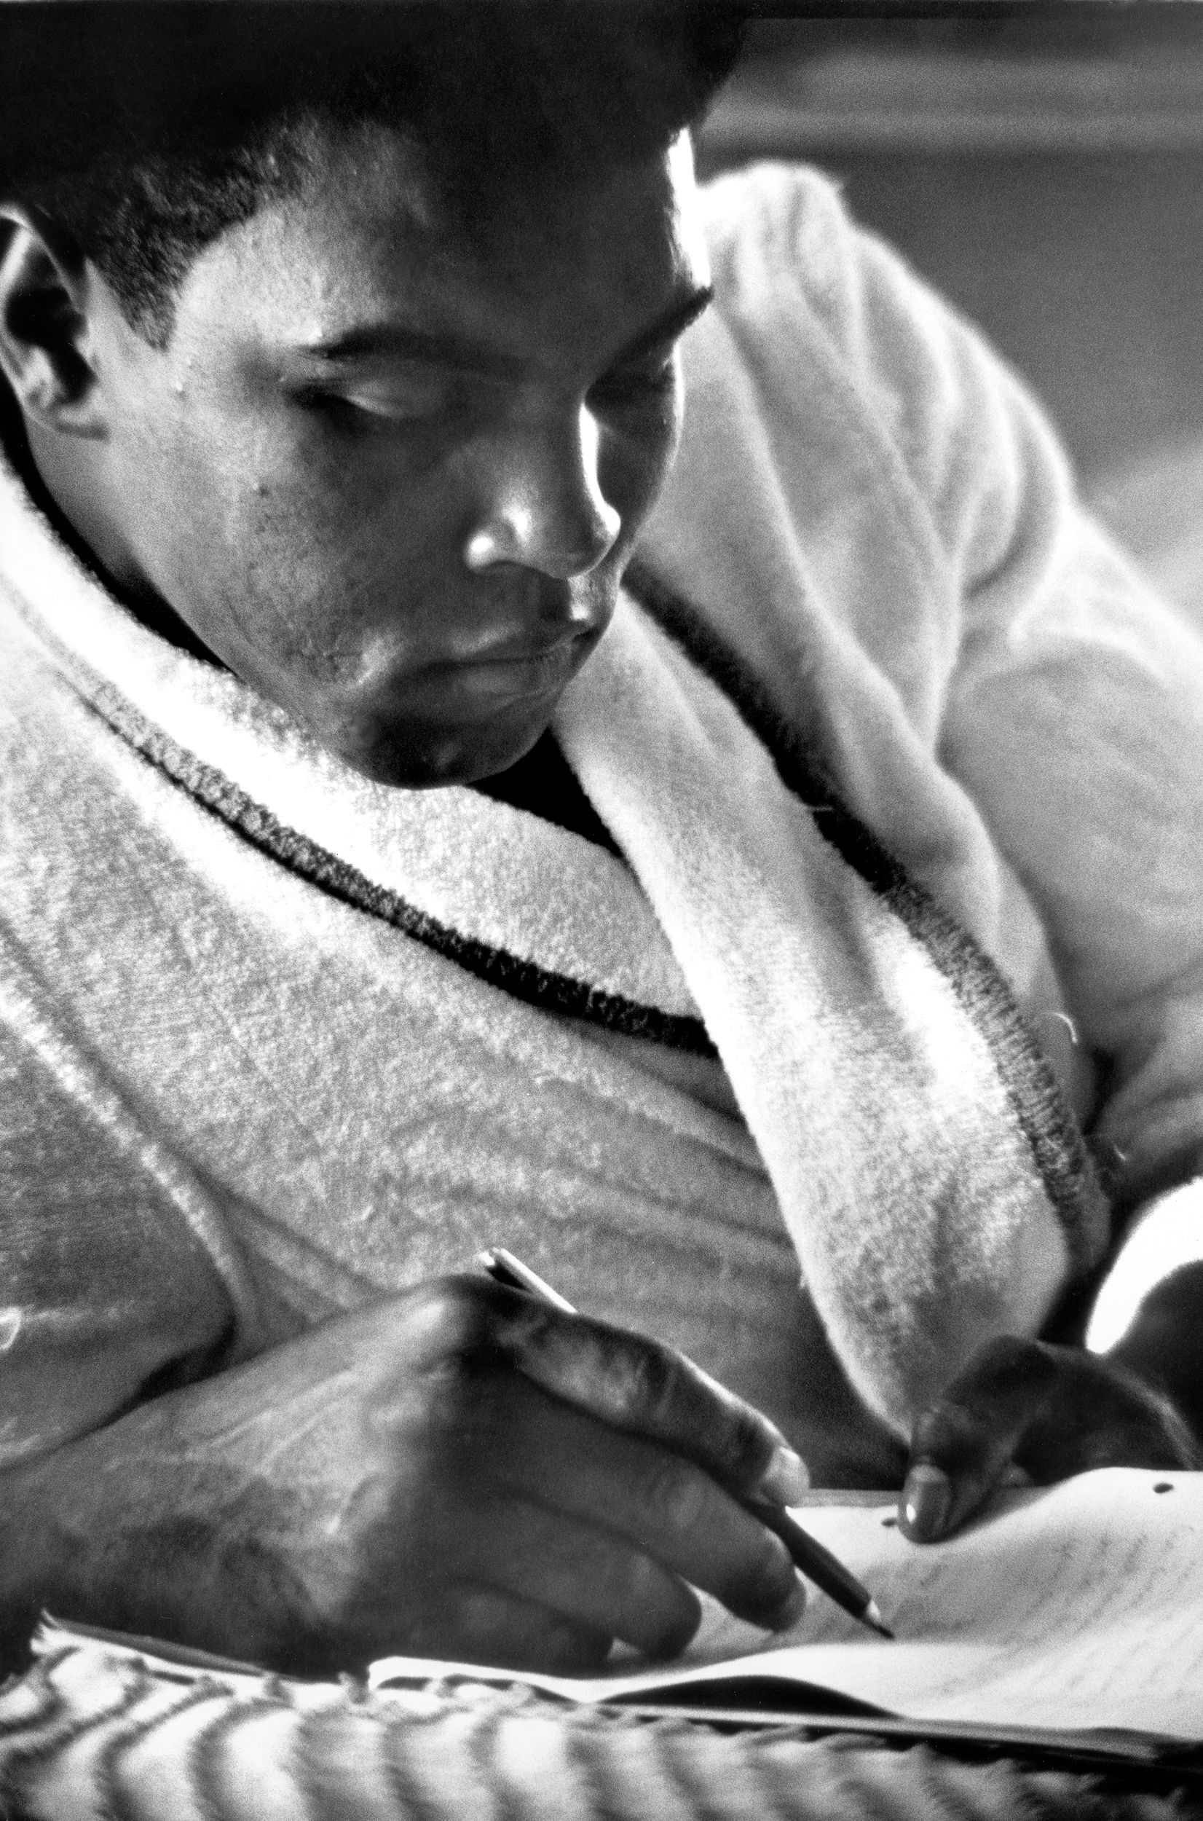

Slide 10
Muhammad Ali
Same era, but reflective, thoughtful, gentle
We cannot see the eyes
Two light sources with primary almost behind subject
Softer lighting from secondary
Least light on the face
Less narrow depth of field, although blurred foreground and background
Light, visible background

Slide 11
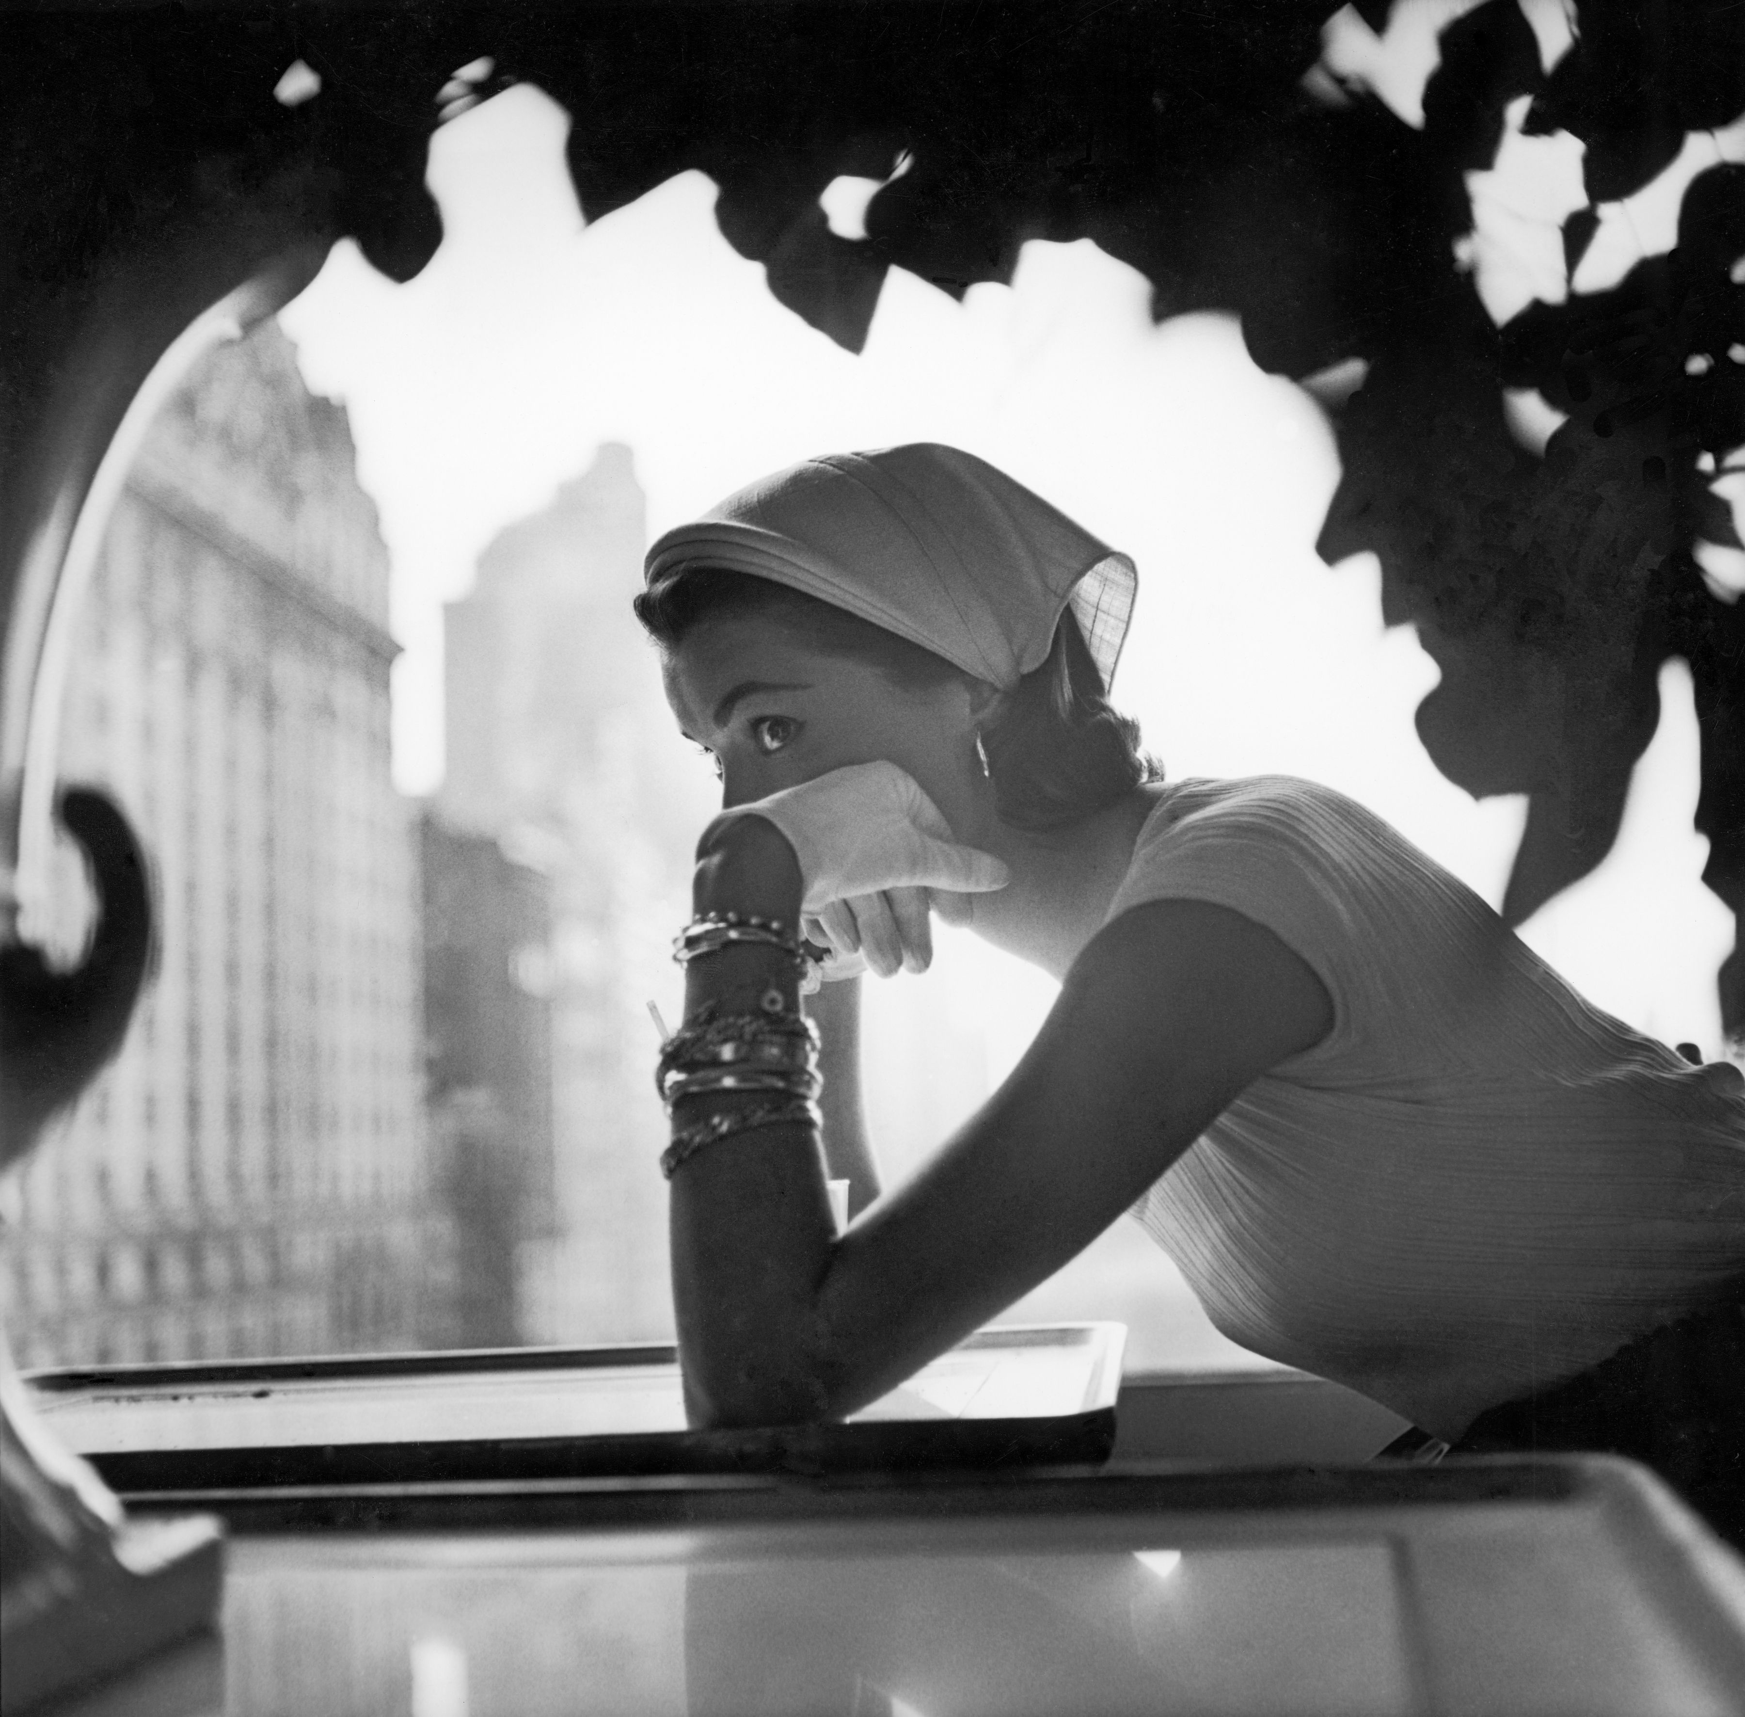

Slide 12
Fashion shot
Big city, sophisticated, full of style
Subject entirely in focus, whilst background and foreground blurred
Two light sources with very bright sunlight behind
Soft, secondary lighting in front of subject
Set in café/restaurant, high up, blurred skyscrapers behind reminding us we are in a large, cultured, worldly and fashionable city

